Slide 1
Craft Beer Presentation To Budweiser CEO and CFO
Presented by: Seemant Srivastava
YouTube Video Presentation Link:
https://youtu.be/CIxdWlPBoXU

Slide 2
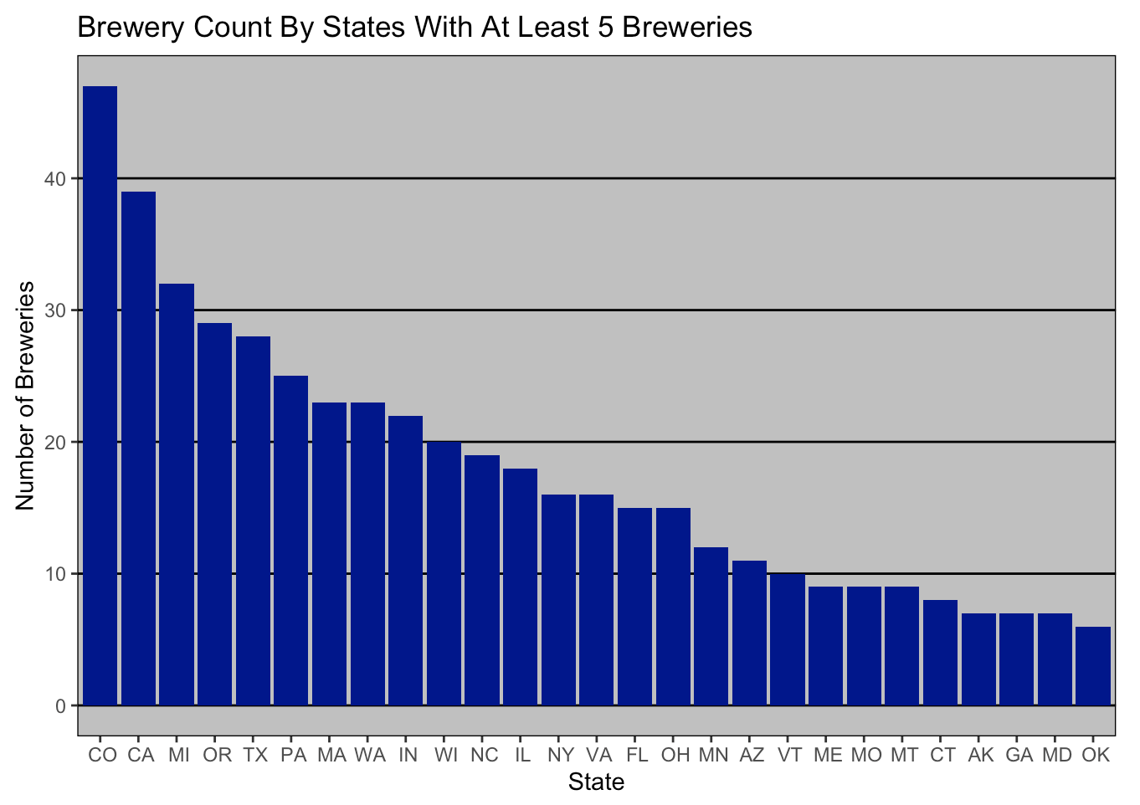
Number OF Breweries In Each State
Colorado has the most breweries
California, Michigan, Oregon, and Texas round out the top five

Slide 3
Addressing The Missing Data Values
We see 1405 observations in the non-imputed code (58.3% of all observations)
These 1405 observations have no missing values
1005 observations have missing IBU values (41.7% of all observations)
62 of these 1005 observations have missing ABV% values
Out of the 1005 missing IBU values, 943 have only IBU missing, whereas 62 are also missing an ABV% value

Slide 4
Addressing Missing Data Values
The blue line represents the distribution of the non-imputed values for both variables
The magenta lines represents the distribution of the imputed values,
Each magenta is an iteration of the imputation function.
Mean Before/After Imputation:
ABV% = 5.977%/5.976%
IBU = 42.71/42.38
Therefore, by imputing the missing ABV% and IBU values we did not alter the summary statistics.

Slide 5
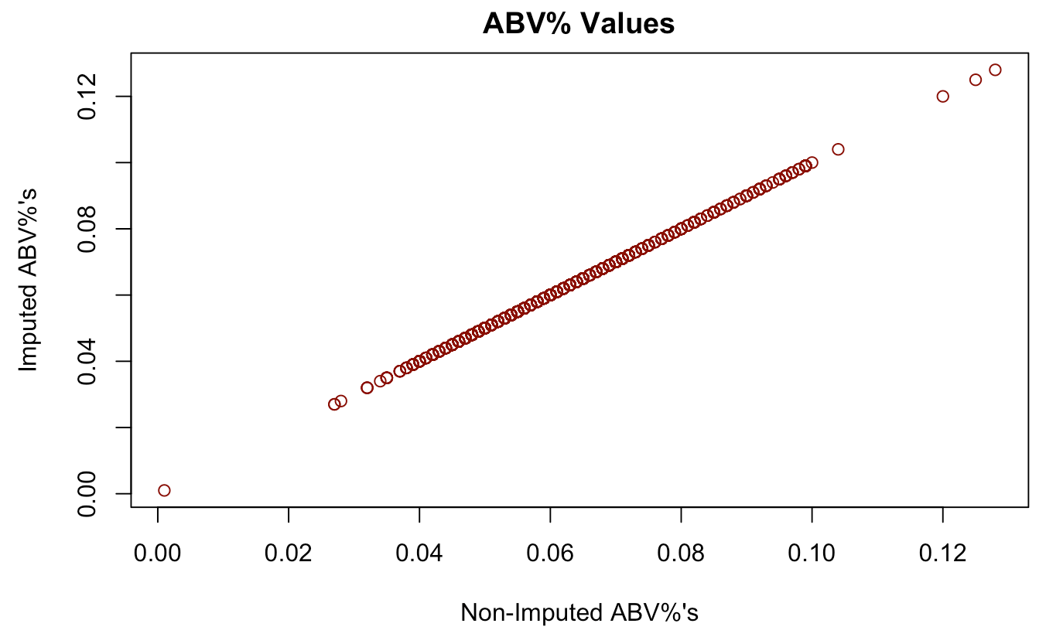
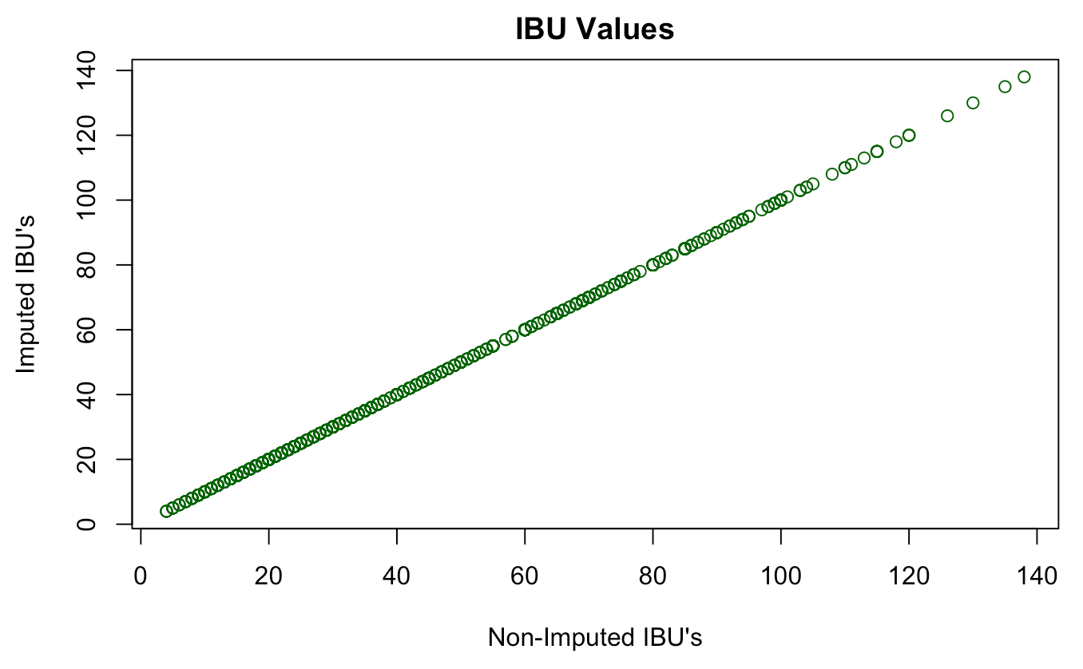
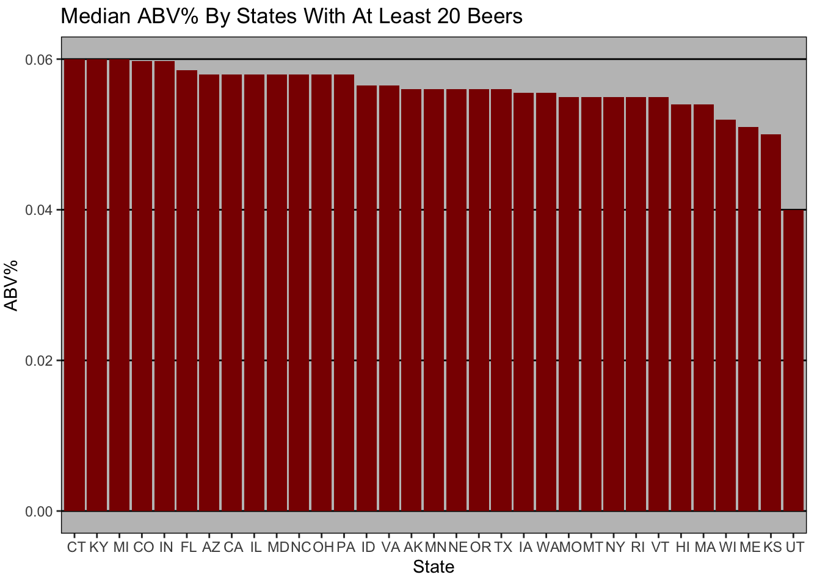
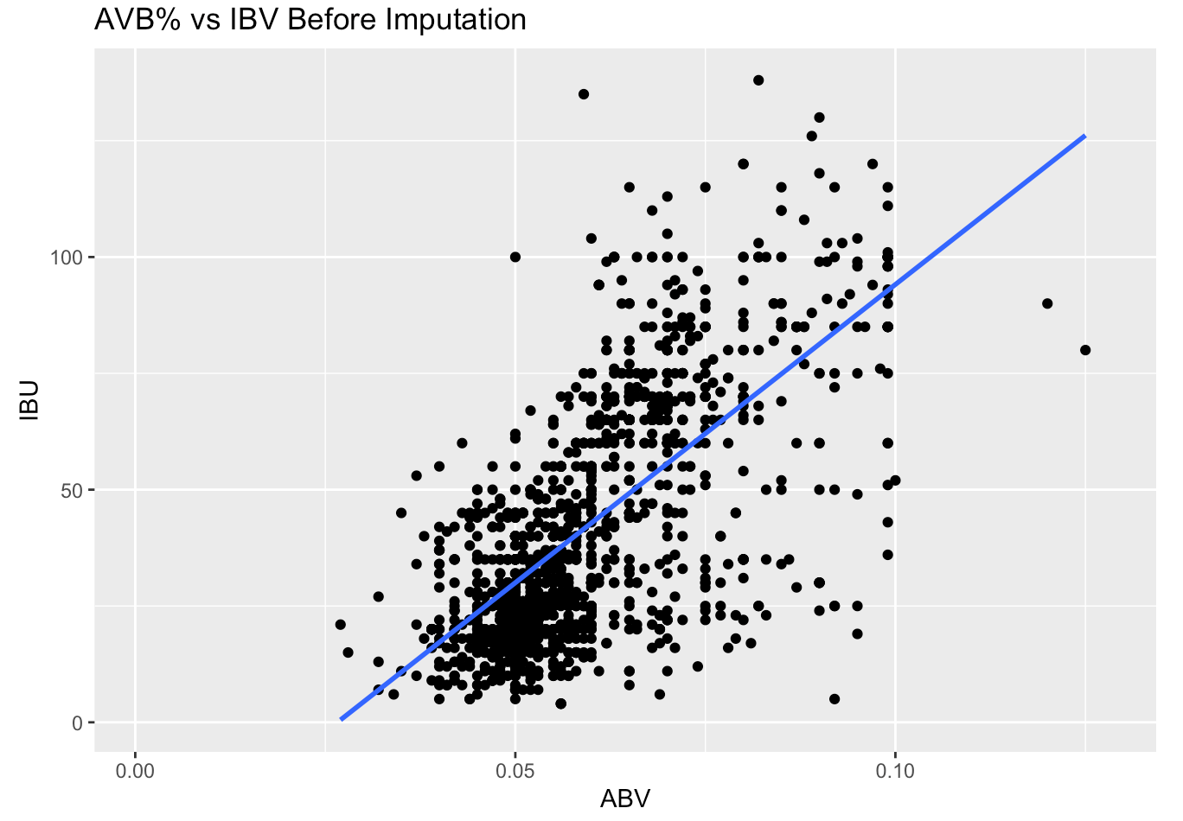
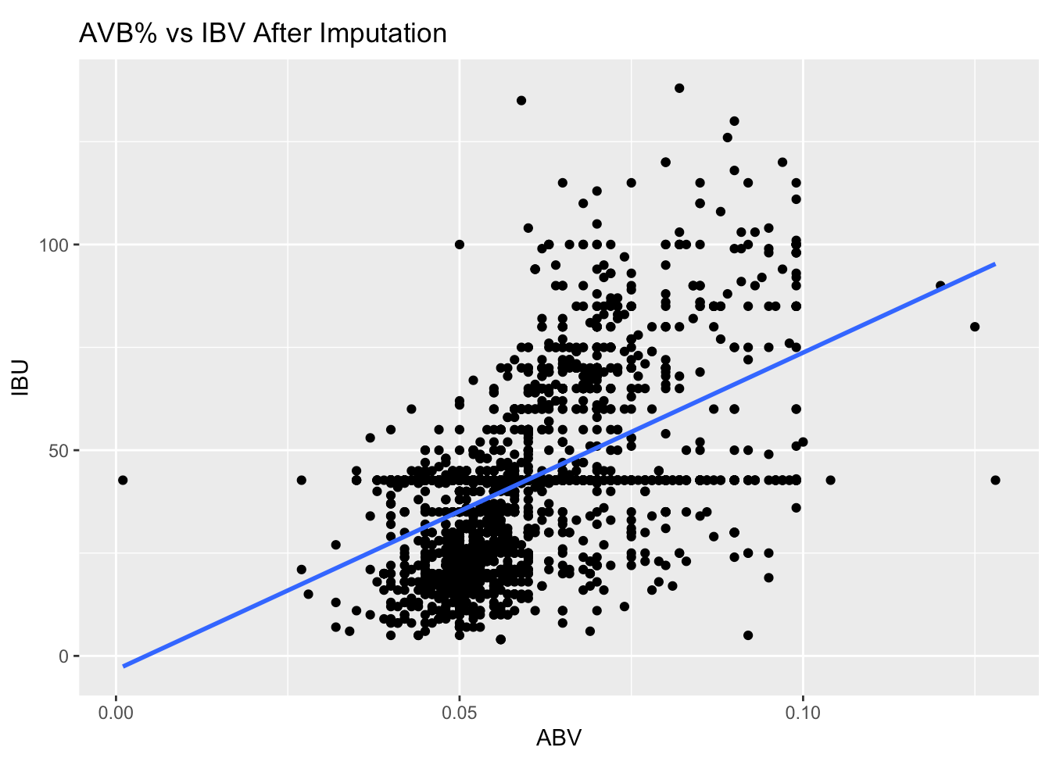
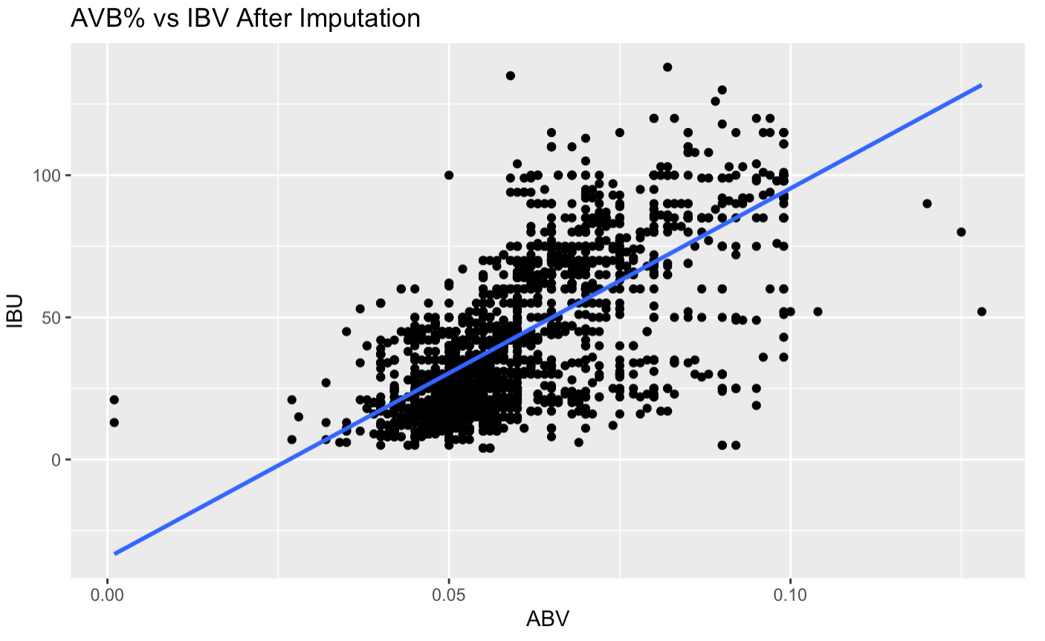
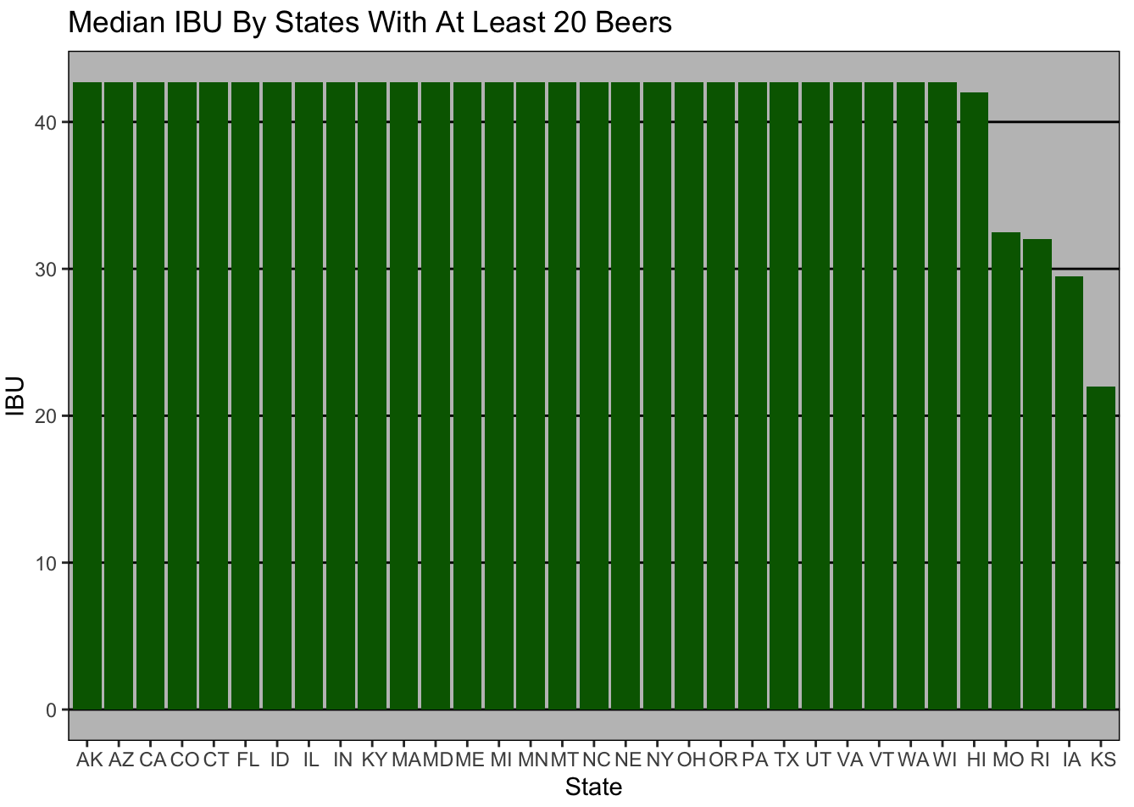
Relationship Between IBU & ABV%

Slide 6
Median ABV% By State
The median ABV% hovers between 4 and 6% for States with at least 20 different beers

Slide 7
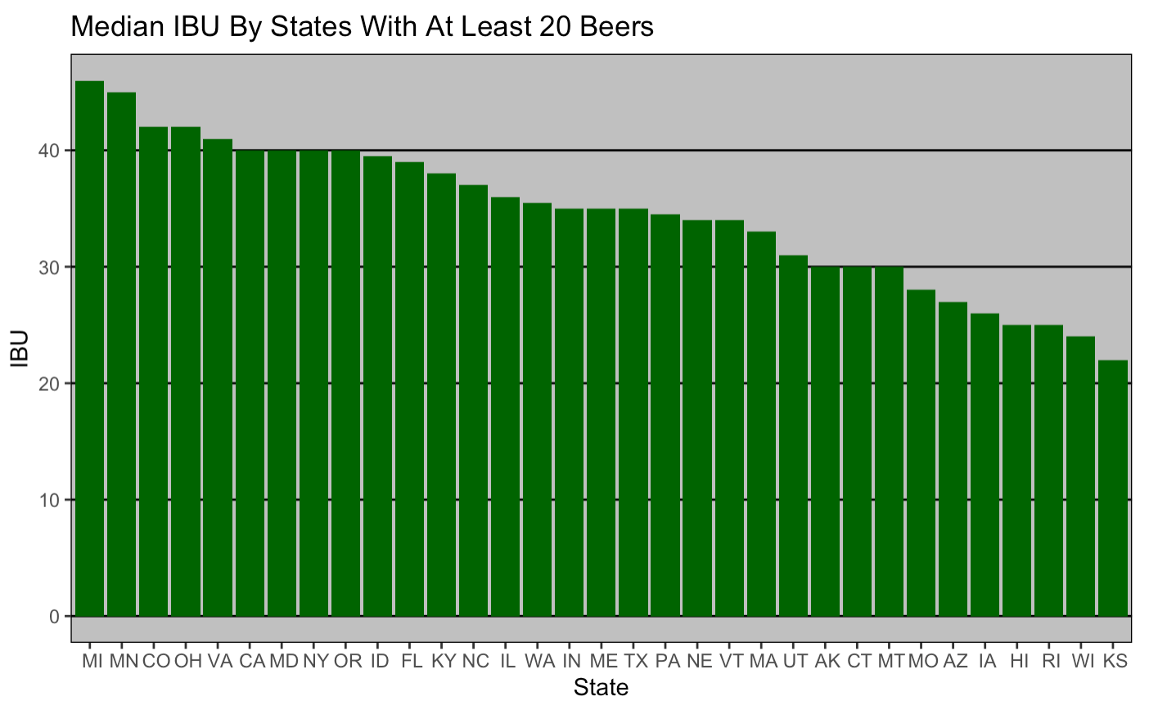
Median IBU By State
The median IBU hovers between 20 and 50 for States with at least 20 different beers

Slide 8
State with Max ABV% BEER
12.8%
The State with the maximum ABV% beer is Colorado (12.8 ABV%)
This is Upslope Brewing Company's Lee Hill Series Vol. 5 - Belgian Style Quadruple Ale

Slide 9
State with Max IBU BEER
138
The State with the maximum IBU beer is Oregon (138 IBU)
This is Astoria Brewing Company's Bitter Bitch Imperial IPA

Slide 10
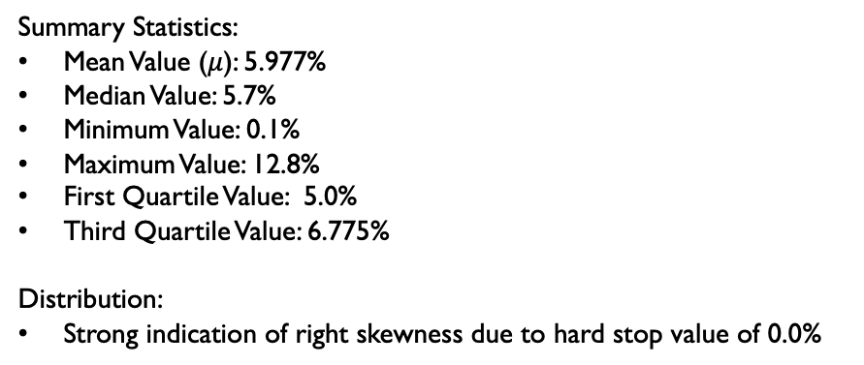
Distribution of ABV%’s
Summary Statistics:
Mean Value ($μ$): 5.977%
Median Value: 5.7%
Minimum Value: 0.1%
Maximum Value: 12.8%
First Quartile Value: 5.0%
Third Quartile Value: 6.775%
Distribution:
Strong indication of right skewness due to hard stop value of 0.0%

Slide 11
Relationship Between IBU & ABV%
There is evidence of moderately strong positive linear correlation between ABV% IBU value for both the non-imputed and imputed data
The correlation value for these two variables is .675, indicating that there is in fact evidence of a moderately strong positive linear relationship

Slide 12
Investigate Difference In ABV% and IBU FOR IPA’s AND ALES
To investigate this relationship ﻿we had to first classify all of the beers in the data set as either an IPA, an Ale, or Other based on beer style in the data set.
For the purposes of this study we are only interested in IPA and Ale observations
We will use both a KNN model and Naïve Bayes model to classify a test set of beers as either an Ale or IPA based on its ABV% and IBU value

Slide 13
What Is KNN?
A KNN model is a way to classify a test set of data by certain characteristics based on an existing set of training data
In our case it is a way for us to classify a beer as either and IPA or an Ale based on its ABV% and IBU value
It compares it by looking at the k nearest neighbors of that ABV% and IBU value point on the scatterplot

Slide 14
KNN Model
k = 9 | Truly Ale | Truly IPA
Classified As Ale | 239 | 57
Classified As IPA | 42 | 122
Metric | Value
Accuracy | 78.48%
Sensitivity | 85.05%
Specificity | 68.16%
Accuracy: Number of correctly classified observations/total
Sensitivity: Number of correctly identified successes/true number of successes
Specificity: Number of correctly identified failures/true number of failures

Slide 15
Naïve Bayes
 | Truly Ale | Truly IPA
Classified As Ale | 246 | 53
Classified As IPA | 47 | 114
Metric | Value
Accuracy | 79.16%
Sensitivity | 83.87%
Specificity | 71.26%
We can see that we get very similar results from our KNN model and Naïve Bayes model, with k-NN model having slightly better sensitivity, which is correctly identifying the successes from the true number of successes .

Slide 16
Further Analysis – Current Offerings
﻿We did further analysis that we feel will prove to increase revenue and profitability for your company.
﻿We started by taking a look at your current beer offerings and the ABV% and IBU values of those beers. Here are the five beers that you sell and their ABV% and IBU value:
﻿BUDWEISER - 5.0% ABV, 12 IBU
﻿BUDWEISER BLACK LAGER - 7.1% ABV, 0 IBU
﻿BUDWEISER SELECT - 4.3% ABV 11 IBU
﻿BUDWEISER SELECT 55 - 3.2% ABV 0 IBU
﻿BUDWEISER & CLAMATO CHELADA - 5% ABV%, 0 IBU
It is clear that Budweiser’s current beer offerings are lower alcohol content (low ABV%) and low IBU value beers.
Now we looked for opportunity in the market based on the craft beer data and Budweiser’s current offerings

Slide 17
Further Analysis – Markets To Push Current Offerings
We assumed that the average ABV% and IBU value in each state represents consumer preference
The states with the lower average ABV% (around 4 and 5%) and lower average IBU value are markets that Budweiser should more heavily focus its products on
Some of these markets include Arkansas, Missouri, and Wisconsin

Slide 18
Further Analysis – Markets To Introduce New Products
Many breweries introduce seasonal or rotational beers based on location
There is opportunity for Budweiser to introduce a small batch rotational beer with an ABV% and IBU value that matches the preference of the market (assuming average values are market preference)
For example, Budweiser could introduce a small batch IPA with a high ABV% and an IBU value above 40 in California

